Slide 1

>>>>> Before You Begin <<<<<
Less is more
Avoid paragraphs and long sentences
Use the 5x5 rule — max of 5 lines, 5 words each
One idea per slide
Notes:
Esri Corporate Template-Dark v4.0
September 29, 2021

Slide 2

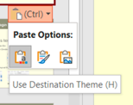
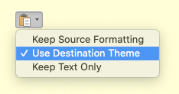
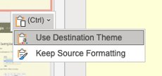

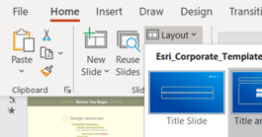
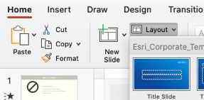
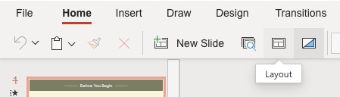
>>>>> Before You Begin <<<<<
How to apply this template
Copy existing slides into this file
When pasting, choose Use Destination Theme
Adjust your slides: titles are now larger and lower on the slide for better visibility
For consistent title placement, you may need to select a layout from the Layout menu
For a brief video tutorial, click here
Windows
Mac
Web
Windows
Mac
Web

Slide 3

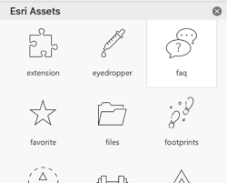
>>>>> Before You Begin <<<<<
Design resources
Icons
Load Esri-created icons straight into your deck!
From the Home ribbon above, click Esri Icons
Presentation Resources [link]
Diagrams, Tables and Timelines [link]
Esri Design Template
Windows [link] | Mac [link]
Backgrounds [link]
Strategic Presentations [link]
Stock photos
Adobe Stock images are available. See the details.

Slide 4


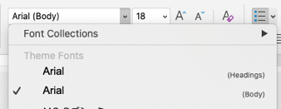
>>>>> Before You Begin <<<<<
Arial or
Use Arial font everywhere
Pick Arial [Headings] or [Body] from the top of the font list
See FAQ “Theme Fonts” for details [link]
Avenir Next is no longer supported
See FAQ “Arial or Avenir Next” for details [link]

Slide 5


Mapping and Exploring Spatial Data in Jupyter Notebooks
Nanae Aubry
Nick Giner
John Yaist
2022 ESRI DEVELOPER SUMMIT
Notes:
2022 Esri Developer Summit

Slide 6


Agenda
What we’ll present
Part I: The Map Widget
Part II: The Spatially Enabled DataFrame
Part III: Python Libraries

Slide 7
The Map Widget
The MapView Class
Resides in the arcgis.widgets module
accessed with the map() method of the GIS class
Communicates with ArcGIS API for JavaScript API
Integrates with Jupyter Notebooks

Slide 8

Using the Map Widget
Demonstrate the basic guide
loading map
centering
zooming
basemaps

Slide 9
ArcGIS Pro Add data and symbolize with class size renderer

Slide 10
Using the Map Widget
Demonstrate the Guide
Adding layers
Symbolize with class size renderer

Slide 11
Part II: The Spatially Enabled DataFrame
The GeoAccessor Class
Bullets

Slide 12
Part III – Python Libraries
Integration with Open Source Coding Patterns
Bullets

Slide 13
Headline
Subhead
Bullets

Slide 14
Headline
Subhead
Bullets

Slide 15



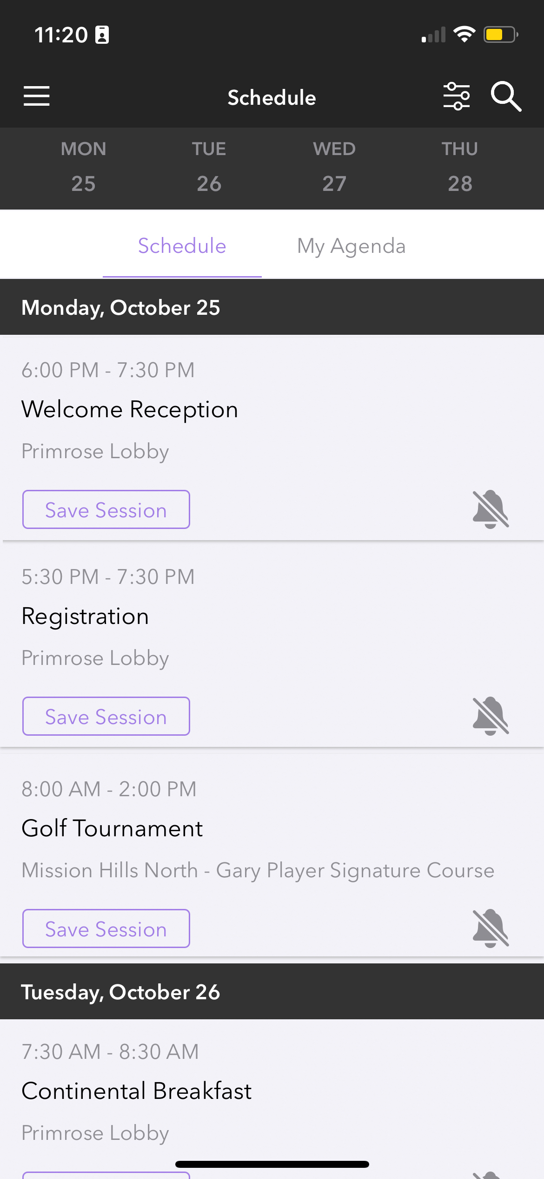
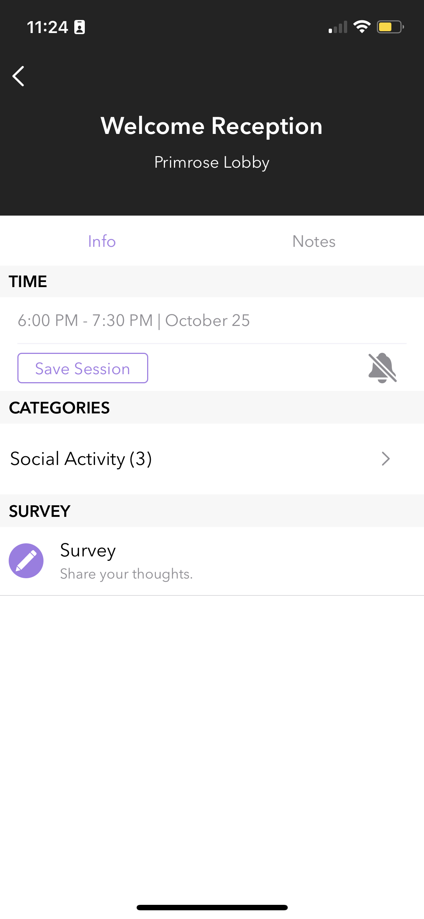
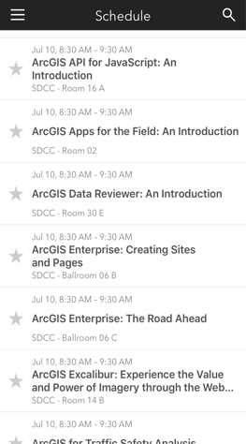
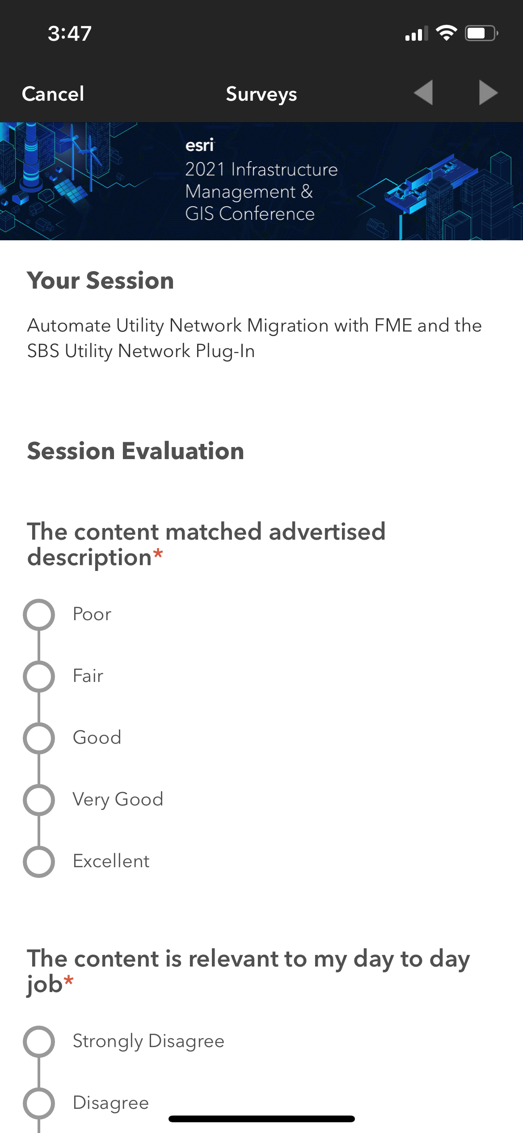
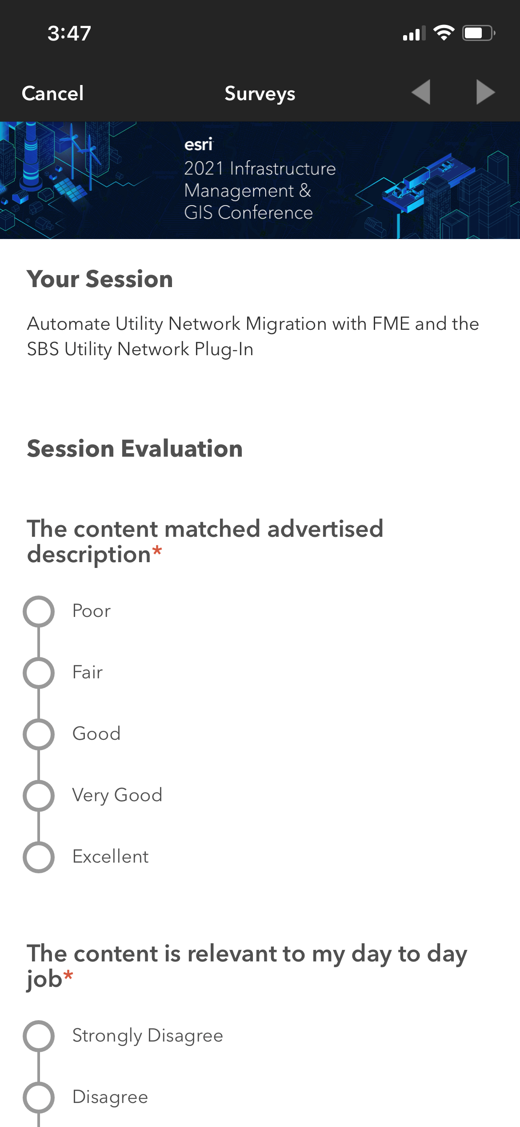
Please Share Your Feedback in the App
Download the Esri Events app and find your event
Select the session you attended
Scroll down to “Survey”
Log in to access the survey

Slide 16



Copyright © 2022 Esri. All rights reserved.

Slide 17
Presentation Title
Presenter Names
2022 ESRI DEVELOPER SUMMIT
Notes:
2022 Esri Developer Summit

Slide 18
Headline
Subhead
Bullets

Slide 19

Headline
Subhead
Bullets

Slide 20

Section Header
Section Subhead

Slide 21

Section Header
Section Subhead

Slide 22
Demo Title
Demo Presenter

Slide 23
Please Share Your Feedback in the App
Download the Esri Events app and find your event
Select the session you attended
Scroll down to “Survey”
Log in to access the survey

Slide 24
Copyright © 2022 Esri. All rights reserved.

